Slide 1
Welcome to
Parent Night of Learning
What do we do at school?

Slide 2
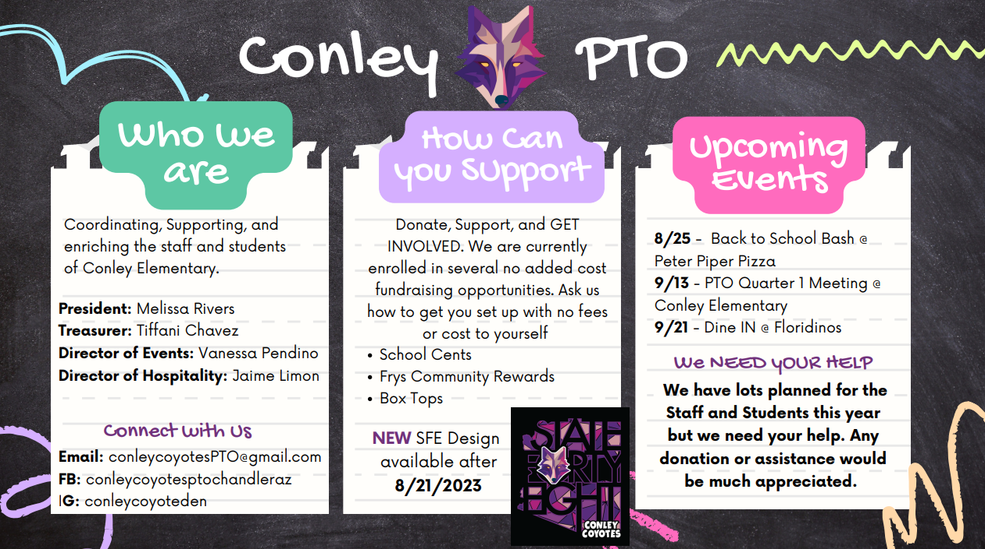
https://www.youtube.com/watch?v=C5rL5rgVv7U&authuser=0

Slide 3
CUSD Early Childhood Philsophy
Build a strong foundation for lifelong learners.
Create experience and discovery.
Provide developmentally appropriate curriculum
Cultivate a love for learning.

Slide 4
The 8 Learning Standards
Approaches to Learning
Science
Fine art
Language and Literacy
mathematics
Physical
Development,
Health
& Safety
Social Studies
Social
Emotional

Slide 5
Topics
Tonight's
What does a day in room 3 look like?
What does potty trained look like at school?
What can you do at home to help your child be successful?
Late Policy
Contact Information and Questions

Slide 6
OUR SCHEDULE
Outdoor Exploration | 8:00-8:40
Routine into classroom | 8:40-8:45
Breakfast | 8:45- 9:05
Opening Circle | 9:05-9:35
learning centers/ therapy/ small group instruction | 9:35-10:25
Bye AM students | 10:25-10:30
Centers/Quiet Time/ Potty & wash hands | 10:30-11:20
Lunch | 11:20-11:40
Whole Group Potty and wash hands | 11:50-11:55
Silent Reading | 11:55-12:05
Tabletop activity-PM Student arrival | 12:05-12:30
Outdoor Exploration | 12:30-1:00
Afternoon Circle | 1:00-1:30
learning centers/ therapy/ small group instruction/Snack | 1:30-2:10
BYE ALL Students | 2:30

Slide 7
Who is in Room 3?
Special education Teacher: Kat Biersdorff
Paraprofessional: Ms. Jayne
Paraprofessional: Ms. Neredia
SLP: Ms. Hannah (on Mondays)

Slide 8
Circle Time
Generally teachers begin this group time with a specific topic for discussion.
Specific routines focused on during circle time are:
Daily Schedule (predictability and group plan)
Singing (rhythm, repetition, rhyme)
Movement
Books
Introduce concepts, letters, and sounds
Demonstrate Projects

Slide 9
Centers and Clean Up
Theme and literacy based centers
Opportunity to work on art projects, themed
or skill based projects, therapy, and IEP goals
Promotes making choices and
encourages social interactions
All students participate in cleaning up
Promotes teamwork and shared responsibility
Encourages responsibility and
respect for their surroundings
Responsibility builds self
confidence

Slide 10
Exploring and investigating the world around us.
Cooperating with others.
Learning to take care of living things.
Observing, predicting, and comparing.
Drawing conclusions.
Developing dexterity and hand-eye coordination.
Practicing motor skills.
Expanding our vocabulary.
Organizing and sharing our learning.
More Than
Just Play

Slide 11
Potty Trained
This is a requirement for all full day students.
Out of pull-ups
Able to request the bathroom.
Able to wipe after using the bathroom.
Able to pull up/down underwear and pants.
Able to dress themselves.

Slide 12
Late Policy
Pick up for your student is at 10:30 or 2:30.
If you are more than 5 minutes late for pick up (10:35 or 2:35) you will pick your student up from the office.
If you know you are going to be late please let me know as soon as possible.
The first time you are late you will be given a verbal warning. After that, you will be charged $1 per minute you are late. This will be added to your CommunityEd account.

Slide 13
What can you do at home?
READ to your child
Sit down together for dinner
Limit Screen time
Utilize a routine
Be a good
language model
Promote
INDEPENDENCE

Slide 14
Contact
Information
Cell: 480-254-7483
Email:
Biersdorff.kathleen@cusd80.com

